Slide 1
Graphs: Models, Terminology & Special Graphs
IT-209: Discrete Mathematics
Rosen, chapter 9 (9.1 & 9.2)

Slide 2
Simple Graph
A simple graph consists of
  a nonempty set of vertices called V
  a set of edges (unordered pairs of distinct elements of V) called E
  Each edge is associated with one or two or more vertices called endpoints.
  An edge is said to be connected with its endpoints.
Notation: G = (V,E)
If a graph has infinite vertices is called infinite graph and with finite vertices is called finite graph.

Slide 3
Simple Graph Example
Detroit
New York
San Francisco
Chicago
Denver
Washington
Los Angeles
This simple graph represents a network.
The network is made up of computers and telephone links between computers.
In a simple graph each edge is connected with a pair of vertices and no two edges are connected with same pair of vertices.

Slide 4
Multigraph
A multigraph can have multiple edges (two or more edges connecting the same pair of vertices).
Detroit
New York
San Francisco
Chicago
Denver
Washington
Los Angeles
There can be multiple telephone lines between two computers in the network.

Slide 5
Pseudograph
A Pseudograph can have multiple edges and loops (an edge connecting a vertex to itself).
Detroit
San Francisco
Chicago
New York
Denver
Washington
Los Angeles
There can be telephone lines in the network from a computer to itself.

Slide 6
Types of Undirected Graphs
Pseudographs
Multigraphs
Simple Graphs

Slide 7
Directed Graphs
A directed graph consists of
  A nonempty set of vertices, V
  A set of directed edges or arcs, E
  The directed edge associated with the ordered pair of vertices (u, v) is said to start u and end at v.
Notation: Directed graph or diagraph G = (V, E)

Slide 8
Directed Graph
The edges are ordered pairs of (not necessarily distinct) vertices.
Detroit
New York
Chicago
San Francisco
Denver
Washington
Los Angeles
Some telephone lines in the network may operate in only one direction.
Those that operate in two directions are represented by pairs of edges in opposite directions.

Slide 9
Directed Multigraph
A directed multigraph is a directed graph with multiple edges between the same two distinct vertices.
  m directed edges, associated with vertices (u, v), then (u, v) is an edge with multiplicity m.
Detroit
New York
Chicago
San Francisco
Denver
Washington
Los Angeles
There may be several one-way lines in the same direction from one computer to another in the network.

Slide 10
Types of Directed Graphs
Directed
Multigraphs
Directed Graphs

Slide 11
Mixed Graph
A graph with both directed and undirected set of edges.
For example a computer network having some links that operate in both direction and some links that operate only in one direction can be modeled using mixed graphs.

Slide 12
Graph Models
Graphs can be used to model structures, sequences, and other relationships.
Example: ecological niche overlay graph
  Species are represented by vertices
  If two species compete for food, they are connected by a vertex

Slide 13
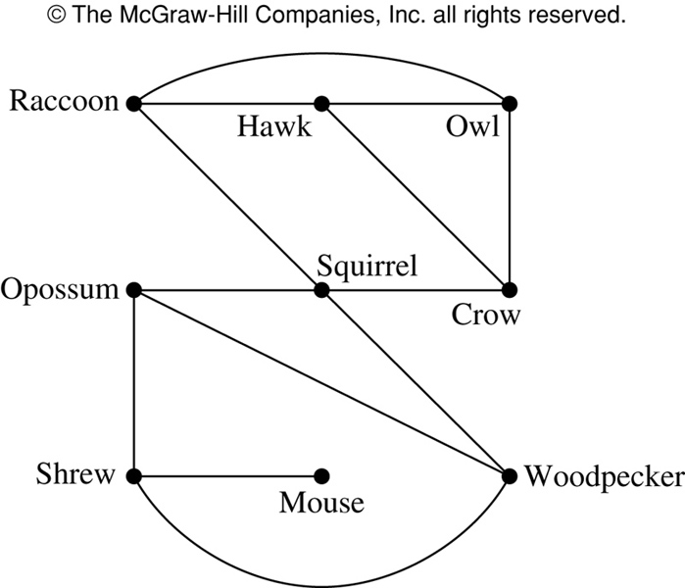
Niche Overlay Graph

Slide 14
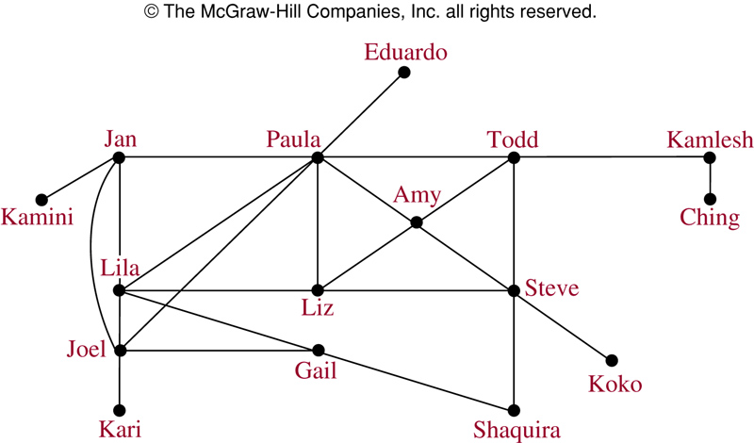
Acquaintanceship Graph

Slide 15
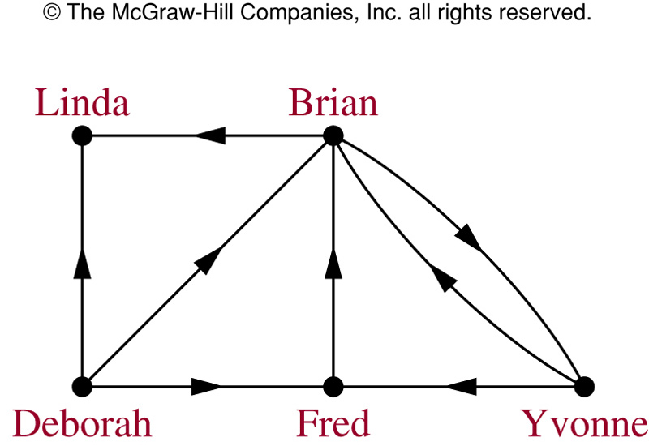
Influence Graph

Slide 16
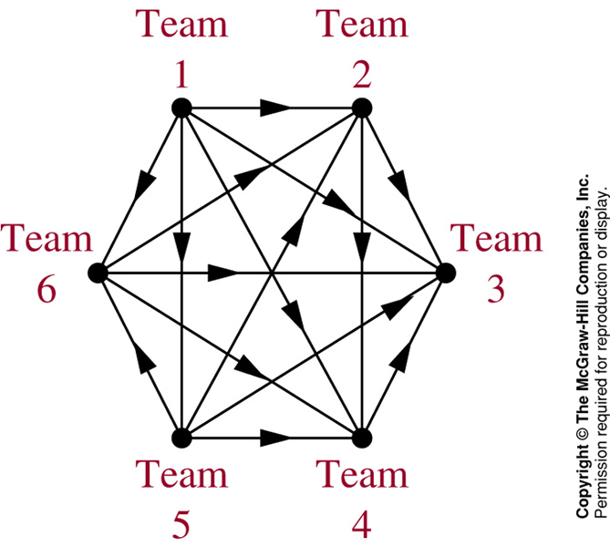
Round-Robin Tournament Graph

Slide 17
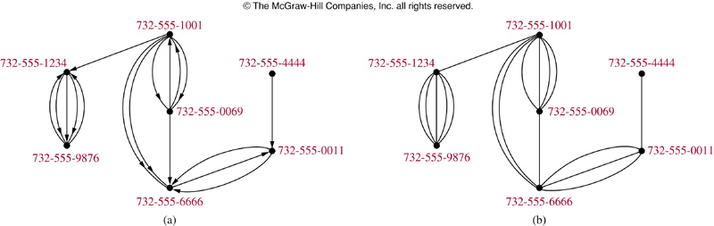
Call Graphs
Directed graph (a) represents calls from a telephone number to another.
Undirected graph (b) represents called between two numbers.

Slide 18
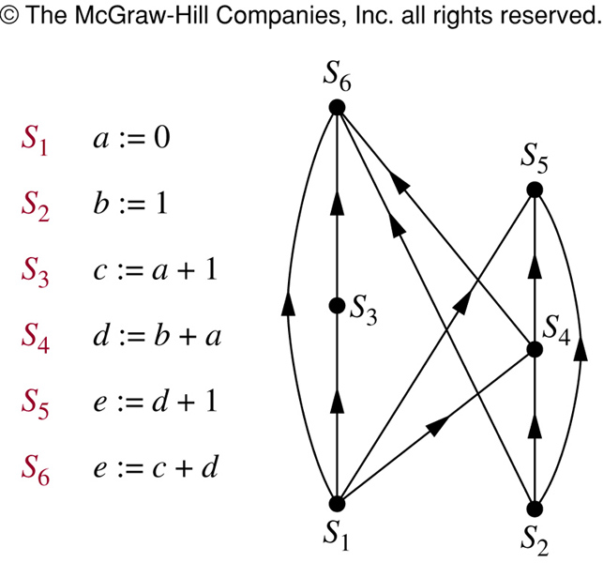
Precedence Graphs
In concurrent processing, some statements must be executed before other statements. A precedence graph represents these relationships.

Slide 19
Summary
Type | Edges | Loops | Multiple Edges
Simple Graph | Undirected | NO | NO
Multigraph | Undirected | NO | YES
Pseudograph | Undirected | YES | YES
Directed Graph | Directed | YES | NO

Slide 20
Rosen, Exercise 9.1, 1(e), 31
Draw a graph model with an edge from each flight from a vertex representing a city where the flight begins to the vertex representing the city where the flight ends. The airline route representing the graph contains everyday
  4 fights from Boston to Newark, 2 flights from Newark to Boston,
  3 flights from Newark to Miami, 2 fights from Miami to Newark,
  1 fight from Newark to Detroit, 2 flights from Detroit to Newark,
  3 from Newark to Washington, 2 flights from Washington to Newark and
  1 flight from Washington to Miami.
Construct a precedence graph for the following program:
  S₁ : x := 0
  S₂ : x := x+1
  S₃ : y := 2
  S₄ : z := y
  S₅ : x := x+2
  S₆ : y := x+z
  S₇ : z := 4

Slide 21
Adjacent Vertices in Undirected Graphs
Two vertices, u and v in an undirected graph G are called adjacent (or neighbors) in G, if {u,v} is an edge of G.
An edge e connecting u and v is called incident with vertices u and v, or is said to connect u and v.
The vertices u and v are called endpoints of edge {u,v}.

Slide 22
Degree of a Vertex
The degree of a vertex in an undirected graph is the number of edges incident with it
  except that a loop at a vertex contributes twice to the degree of that vertex
The degree of a vertex v is denoted by deg(v).

Slide 23
Example
c
d
b
a
g
f
e
Find the degrees of all the vertices:
deg(a) = 2, deg(b) = 6, deg(c) = 4, deg(d) = 1,
deg(e) = 0, deg(f) = 3, deg(g) = 4

Slide 24
Adjacent Vertices in Directed Graphs
When (u,v) is an edge of a directed graph G, u is said to be adjacent to v and v is said to be adjacent from u.
(u, v)
initial vertex terminal vertex

Slide 25
Degree of a Vertex
In-degree of a vertex v
  The number of vertices adjacent to v (the number of edges with v as their terminal vertex
  Denoted by deg⁻(v)
Out-degree of a vertex v
  The number of vertices adjacent from v (the number of edges with v as their initial vertex)
  Denoted by deg⁺(v)
A loop at a vertex contributes 1 to both the in-degree and out-degree.

Slide 26
Example
a c
b
e d f
Find the in-degrees and out-degrees of this digraph.
In-degrees: deg⁻(a) = 2, deg⁻(b) = 2, deg⁻(c) = 3, deg⁻(d) = 2, deg⁻(e) = 3, deg⁻(f) = 0
Out-degrees: deg⁺(a) = 4, deg⁺(b) = 1, deg⁺(c) = 2, deg⁺(d) = 2, deg⁺(e) = 3, deg⁺(f) = 0

Slide 27
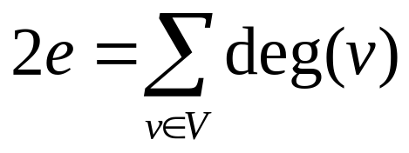
Theorem 1: Handshaking Theorem
Let G = (V, E) be an undirected graph with e edges. Then
Example: How many edges are there in a graph with 10 vertices each of degree six?
Solution: Number of vertices = 10, each has degree 6, then the sum of degree of vertices = 6 * 10 = 60
i. e. 2e = 60
=> e = 60/2 = 30; Number of edges = 30.

Slide 28
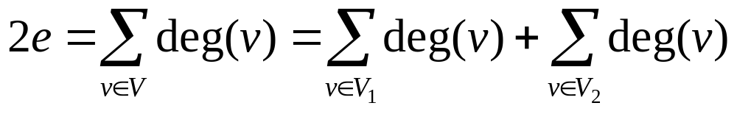
Theorem 2
An undirected graph has even number of vertices of odd degree.
Proof: Let V₁ and V₂ are set of even degree and odd degree vertices of G = (V, E). Then
We have to have even term at right side because at left side we have 2e which is even. The first term of the second equality of right side is even as it is the sum of even degree vertices. The second term of right side must have to be even to have a even term at right side.

Slide 29
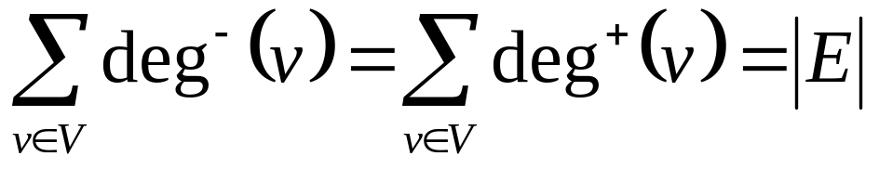
Theorem 3
The sum of the in-degrees of all vertices in a digraph = the sum of the out-degrees = the number of edges.
Let G = (V, E) be a graph with directed edges. Then:
From the example shown before:
  In-degrees: deg⁻(a) = 2, deg⁻(b) = 2, deg⁻(c) = 3, deg⁻(d) = 2, deg⁻(e) = 3, deg⁻(f) = 0
  Sum of in-degree = 2+2+3+2+3+0= 12
  Out-degrees: deg⁺(a) = 4, deg⁺(b) = 1, deg⁺(c) = 2, deg⁺(d) = 2, deg⁺(e) = 3, deg⁺(f) = 0
  Sum of out-degree = 4+1+2+2+3+0= 12
  i.e. Number of edges = 12

Slide 30
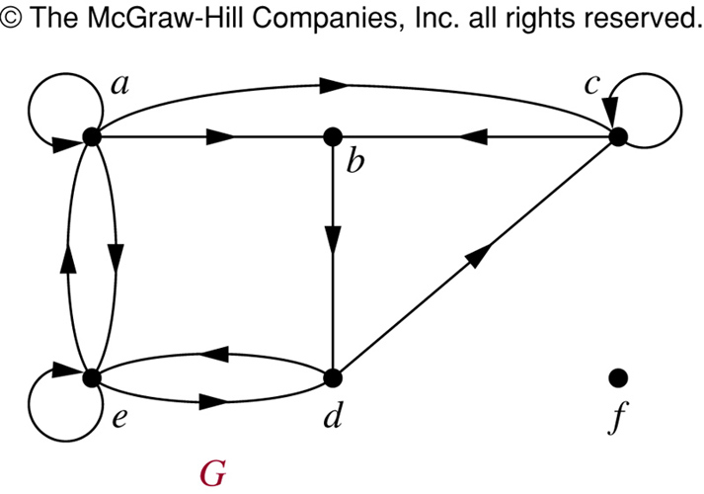
Example

Slide 31
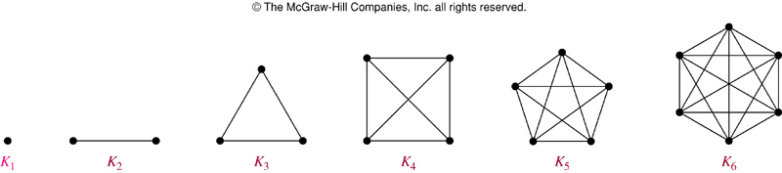
Complete Graph
The complete graph on n vertices (K_{n}) is the simple graph that contains exactly one edge between each pair of distinct vertices.
The figures above represent the complete graphs, K_{n}, for n = 1, 2, 3, 4, 5, and 6.

Slide 32
Cycle
The cycle C_{n} (n ≥ 3), consists of n vertices v₁, v₂, …, v_{n} and edges {v₁,v₂}, {v₂,v₃}, …, {v_{n-1},v_{n}}, and {v_{n},v₁}.
Cycles:
C₃
C₄
C₅
C₆

Slide 33
Wheel
When a new vertex is added to a cycle C_{n} and this new vertex is connected to each of the n vertices in C_{n}, we obtain a wheel W_{n}.
Wheels:
W₃
W₄
W₅
W₆

Slide 34
n-Cubes
The n-dimensional hypercube, or n-cube denoted by Q_{n} is the graph that has vertices representing the 2^{n} bit strings of length n.
Two vertices are adjacent iff the bit string that they represent differ in exactly one bit position.
Example: Q₃ is shown here, where
  Bit string of length 3 is represented
  We have 2³ = 8 vertices
110
111
100
101
010
011
000
001

Slide 35
Bipartite Graph
A simple graph is called bipartite if its vertex set V can be partitioned into two disjoint nonempty sets V₁ and V₂ such that every edge in the graph connects a vertex in V₁ and a vertex in V₂ (so that no edge in G connects either two vertices in V₁ or two vertices in V₂).
a b
c d
e
a
d
e
b
c

Slide 36
Bipartite Graph (Example)
V₁
V₂
V₆
V₃
Is C₆ Bipartite?
Yes. Why?
Because:
its vertex set can be partitioned into the two sets V₁ = {v₁, v₃, v₅} and V₂ = {v₂, v₄, v₆}
every edge of C₆ connects a vertex in V₁ with a vertex in V₂
V₅
V₄

Slide 37
Bipartite Graph (Example)
V₁
Is K₃ Bipartite?
No. Why not?
V₂
V₃
Because:
Each vertex in K₃ is connected to every other vertex by an edge
If we divide the vertex set of K₃ into two disjoint sets, one set must contain two vertices
These two vertices are connected by an edge
But this can’t be the case if the graph is bipartite

Slide 38
Complete Bipartite Graph
The complete bipartite graph, K_{m,n} is the graph that has its vertices partitioned into subsets of m and n vertices.
There is edge between two vertices iff one vertex is in m and other is in n.
Example:
K_{3,3}
K_{2,6}

Slide 39
Subgraph
A subgraph of a graph G = (V,E) is a graph H = (W,F) where W ⊆ V and F ⊆ E.
K₅
C₅
Is C₅ a subgraph of K₅?

Slide 40
Union
The union of 2 simple graphs G₁ = (V₁, E₁) and G₂ = (V₂, E₂) is the simple graph with vertex set V = V₁∪V₂ and edge set E = E₁∪E₂. The union is denoted by G₁∪G₂.
c
c
c
b
d
f
f
b
d
b
d
a
e
e
a
e
a
S₅
C₅
W₅
S₅ ∪ C₅ = W₅

Slide 41
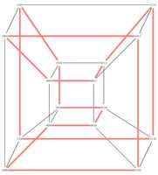
Rosen, Exercise 9.2, 20
Draw K₇, K_{1,8} , K_{4,4},C₇,W₇,Q₄

Slide 42
Thank You
Study all the solved problem from your text book.
Try to solve related problems from exercise.
Text from Rosen 8.5

